Slide 1

Every Day Counts
Woodside Attendance Initiative

Slide 2

Every Day Counts

Slide 3

Every Day Counts
Alternative video for grades 4 and 5

Slide 4

Key Messages
Key Message #1: Good attendance helps children do well in school and eventually in the work place.

Slide 5
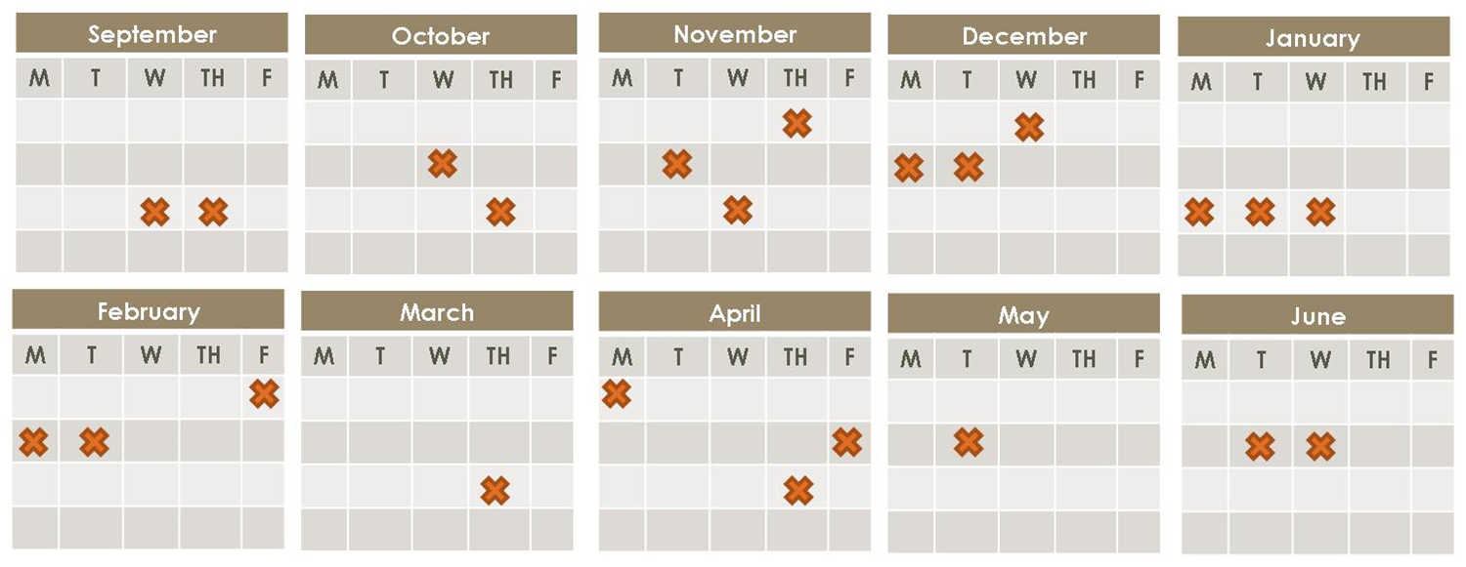
Key Message #2: Absences add up. Excused and unexcused absences result in too much time lost in the classroom.

Slide 6

Key Message #3: Chronic absence, missing 10 percent of the school year or more, affects the whole classroom, not just the students who miss school.

Slide 7
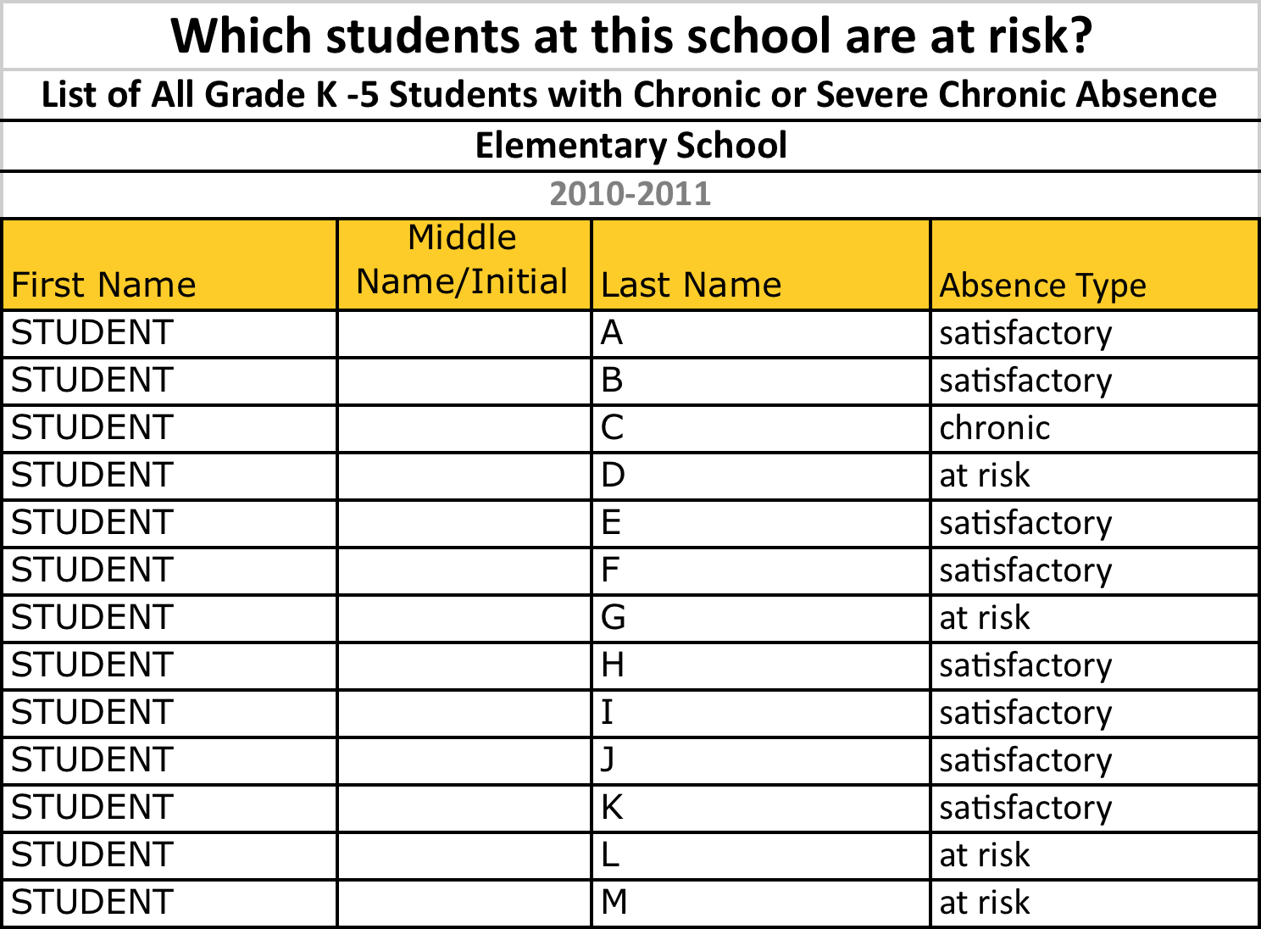
Key Message #4: We monitor how many days each student misses school for any reason — excused, unexcused or suspensions — so we can intervene early.

Slide 8

Key Message #5: Chronic absence is a problem we can solve when the whole community, including parents and schools, gets involved.

Slide 9
Woodside Toucans Attendance Plan
Weekly, classes with attendance at 97% or above and the grade level with the highest attendance will be recognized during morning announcements.
Weekly grade level percentages will be posted on a bulletin board in the office.
Attendance awards will be given out each month with recognition at SOAR assemblies.
Recognition on PTA social media.
Weekly SOAR slips to each student in the grade level with the best attendance.
Each month, students with 97+% on-time attendance will be entered into a drawing for a reward or prize. Two student names will be chosen each month.

Slide 10
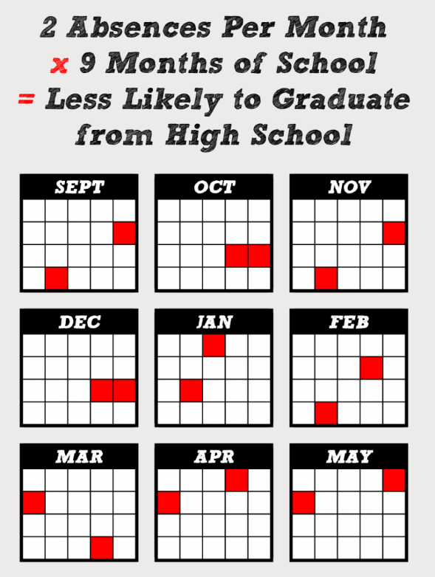

Slide 11

Let’s SOAR together and make EVERY day count!

